Slide 1

Data Warehouse Design and Visualization on Power BI

Slide 2
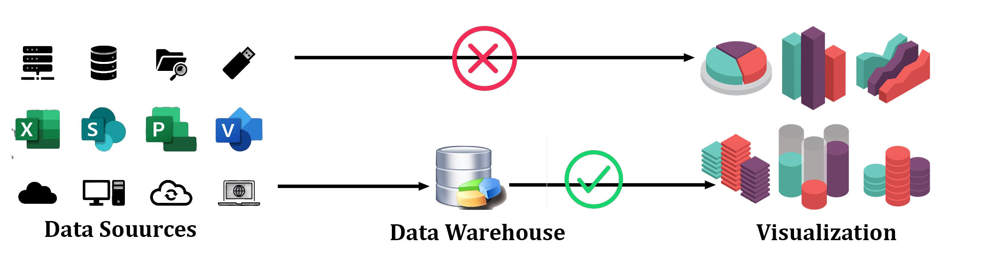
Why Data Warehouse
Data collected from various sources and stores in various databases cannot be directly visualize.
The data first needs to be integrated and the then processed before visualization take place.

Slide 3
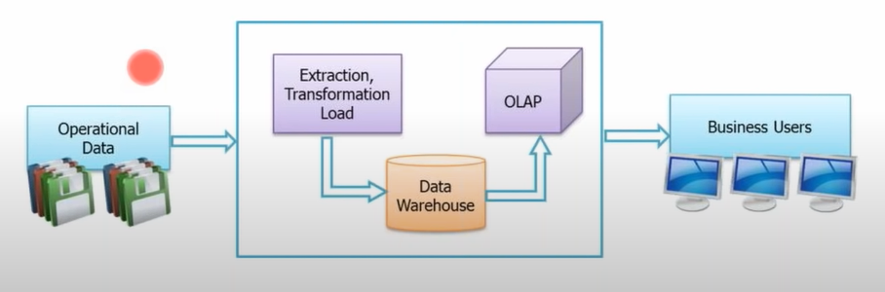
What is a Data Warehouse?
A central location where consolidated data from multiple locations(database) are stored.
It is maintained separately from an organization’s operational database.
End users access it whenever any information is needed.
Note: Data Warehouse is not loaded every time new data is added to database.

Slide 4
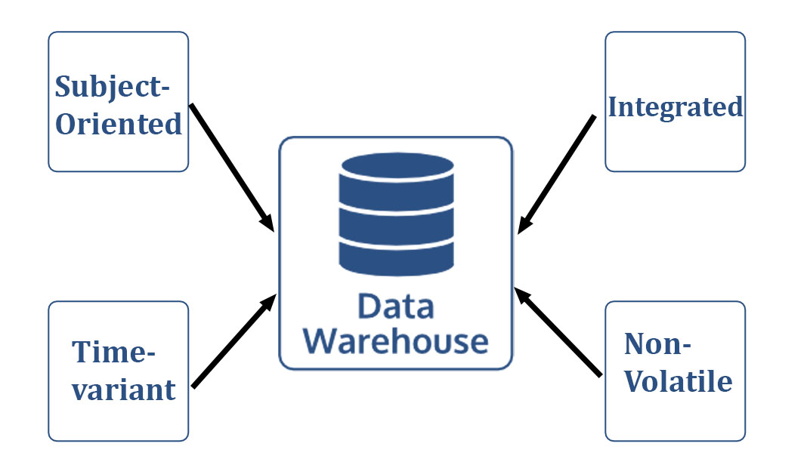
Properties of Data Warehouse “A Data Warehouse is a Subject-oriented, integrated, time-variant and nonvolatile collection of data in support of management’s decision-making process.” -Bill Inmon, Father of Data Warehousing
Subject-oriented: - Data is categorized and stored by business subject rather than by application.
Integrated: -Data on a given subject is collected from disparate sources and stored in a single place.
Time-variant: - Data is stored as a series of snapshots, each representing a period
Non-volatile: - Typically data in the data warehouse is not updated or deleted.

Slide 5
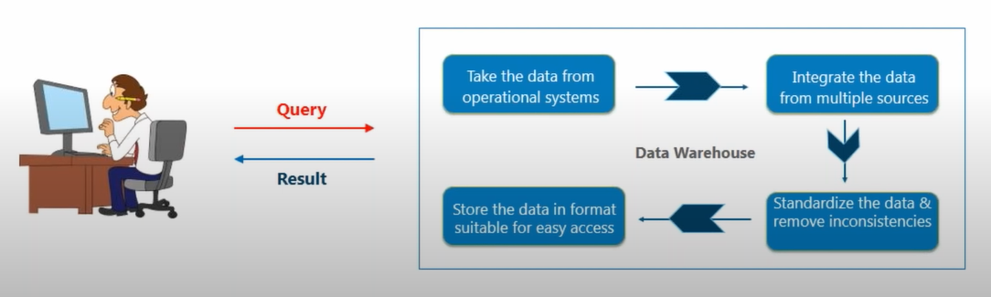
Advantages Of Data Warehouse
Strategic questions can be answered by studying trends.
Data Warehousing is faster and more accurate.
Note: - Data warehouse is not a product that a company can go and purchase, it needs to be designed and depends entirely on the company’s requirement.

Slide 6
Relational Databases (OLTP) | Analytical Data Warehouse (OLAP)
Contains current data | Contains historical data
Useful in running business | Useful in analyzing the business
Based on Entity Relationship model | Based on Star, Snowflake and Fact Constellation Schema
Provides primitive and highly detailed data | Provides summarized and consolidated data
Used for writing data into the database | Used for reading data from the data warehouse
Database size ranges from 100 MB to 1 GB | Data Warehouse size ranges from 100GB to 1 TB
Fast; provides high performance | Highly flexible; bit not fast
Number of records accessed is in tens | Number of records accessed is in millions
EX: All bank transactions made by customer | Ex: Bank transactions made by a customer at a particular time

Slide 7
OLTP Examples:
A supermarket server which records every single product purchased at that market.
A bank server which records every time a transaction is made for a particular account.
A railway reservation server which records the transactions of a passenger.
OLAP Examples:
Bank Manager wants to know how many customers are utilizing the atm of his branch. Based on this he may take a call whether to continue with the ATM or relocate it.
An insurance company wants to know the number of policies each agent has sold. This will help in better performance management of agents.

Slide 8

De-normalization
Normalization in a data warehouse may lead to lots of small tables
Can lead to excessive I/O’s since many tables must be accessed
De-normalization is the answer especially since updates are rare

Slide 9

Dimension tables
The tables that describe the dimensions involved are called Dimension tables.
Dividing a Data Warehouse project into dimensions provide structured information for analysis and reporting
Define business in terms already familiar to users
Wide rows with lots of descriptive text
Small tables (about a million rows)
Joined to fact table by a foreign key
heavily indexed
typical dimensions
End users fire queries on these dimension tables which contain descriptive information

Slide 10

Fact Table
Central table
A fact is a measure that can be summed, averaged or manipulated
A fact table contains 2 kinds of data – a dimension key and a measure.
Every Dimension table is linked to a Fact table.
mostly raw numeric items
narrow rows, a few columns at most
large number of rows (millions to a billion)
Access via dimensions

Slide 11

Schemas
Gives the logical description of the entire database
Database organization
must look like business
must be recognizable by business user
approachable by business user
Must be simple
Schema Types
Star Schema
Fact Constellation Schema
Snowflake schema

Slide 12
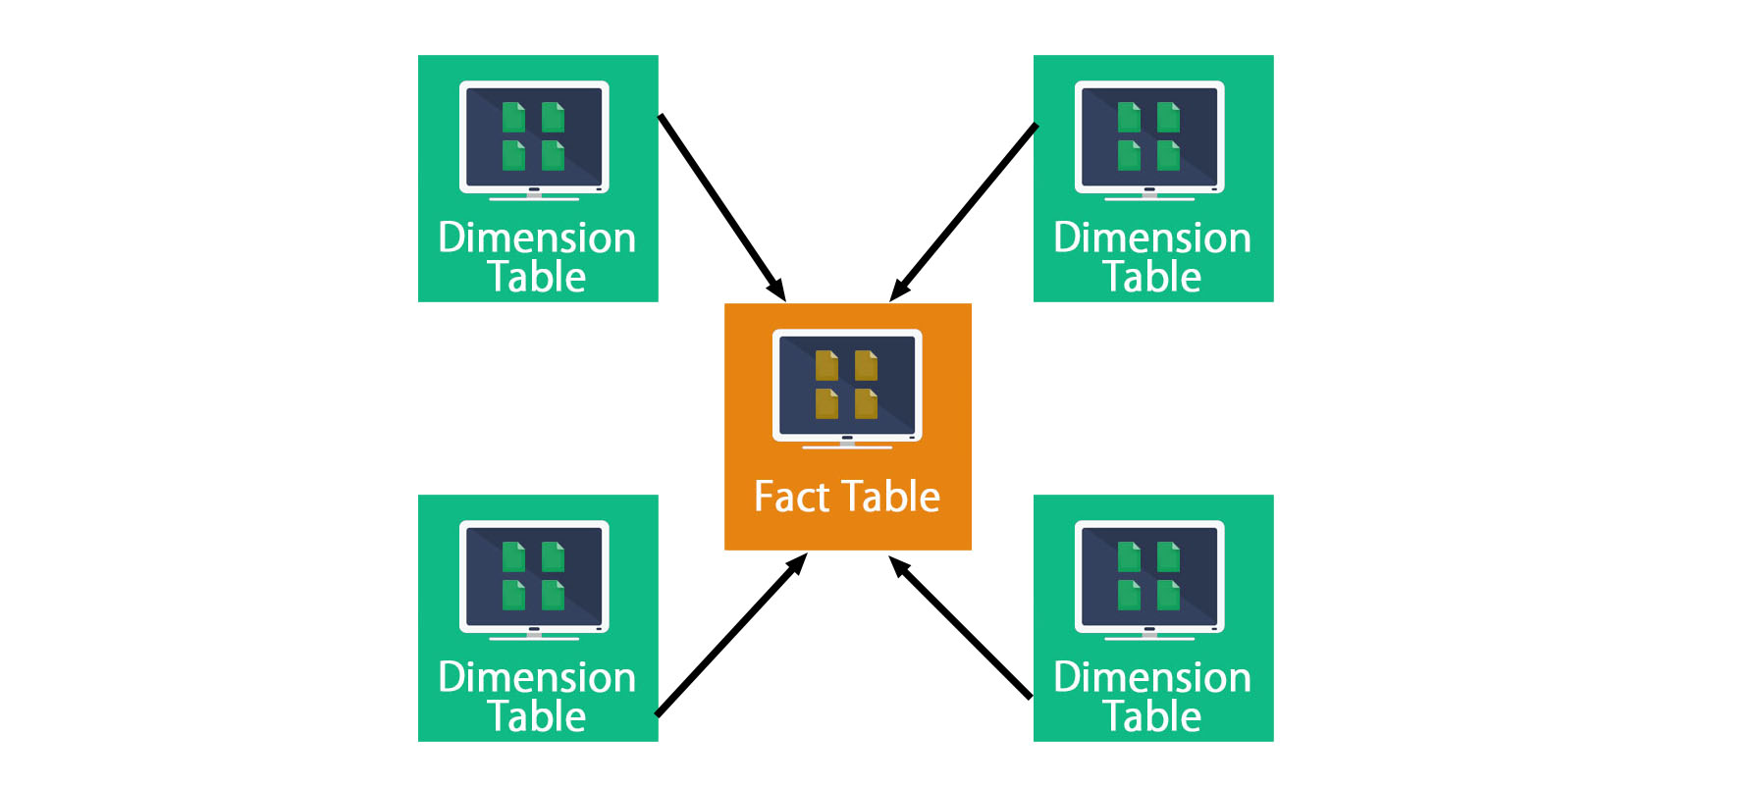
Star Schema
A single fact table and for each dimension one dimension table
Does not capture hierarchies directly

Slide 13
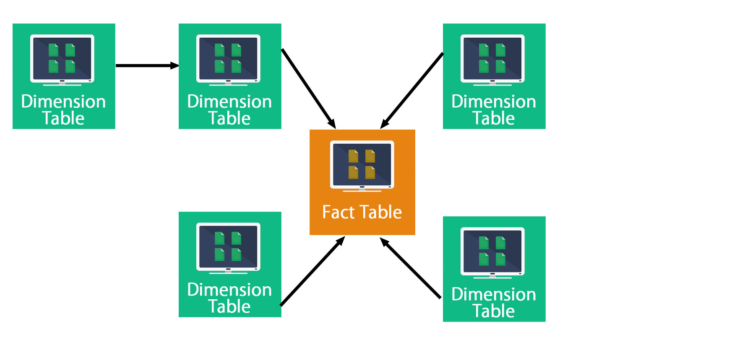
Snowflake Schema
Represent dimensional hierarchy directly by normalizing tables.
Easy to maintain and saves storage
Dimension table are normalized

Slide 14
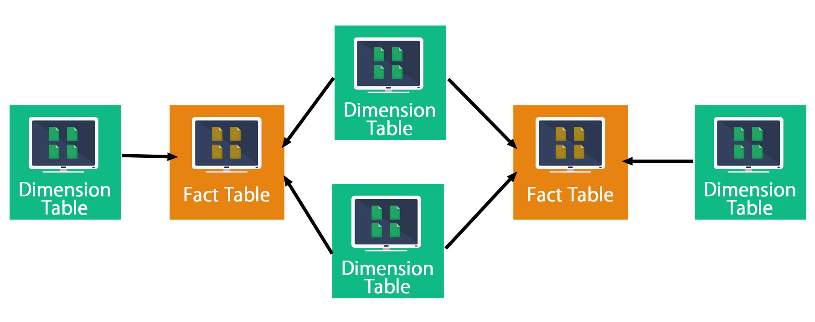
Galaxy Schema
Also know as Fact Constellation schema.
Multiple fact tables that share many dimension tables.

Slide 15
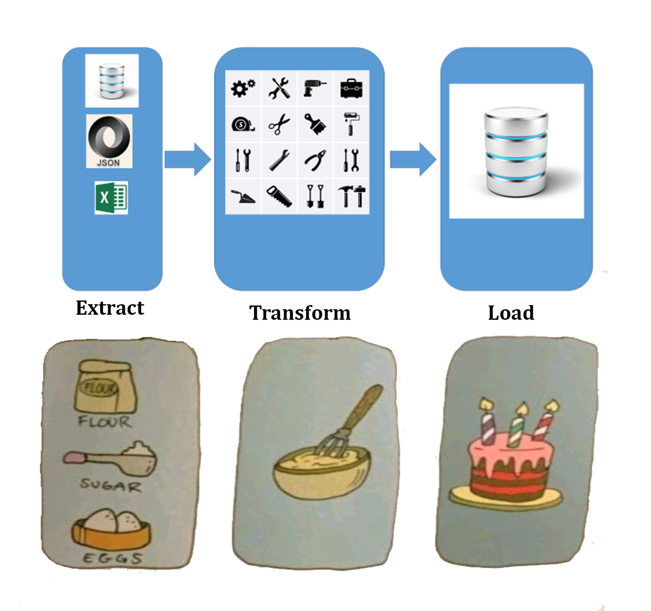
ETL
It is process of suiting software to extract the desired data from various sources, the transform that data by using rules and lookup tables to meet requirement, and then loading it into a target data warehouse

Slide 16
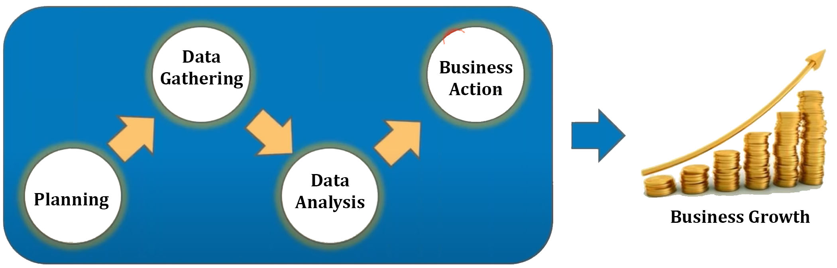
Why BI Needed?
Business Intelligence is the activity which contributes to the growth of company.

Slide 17
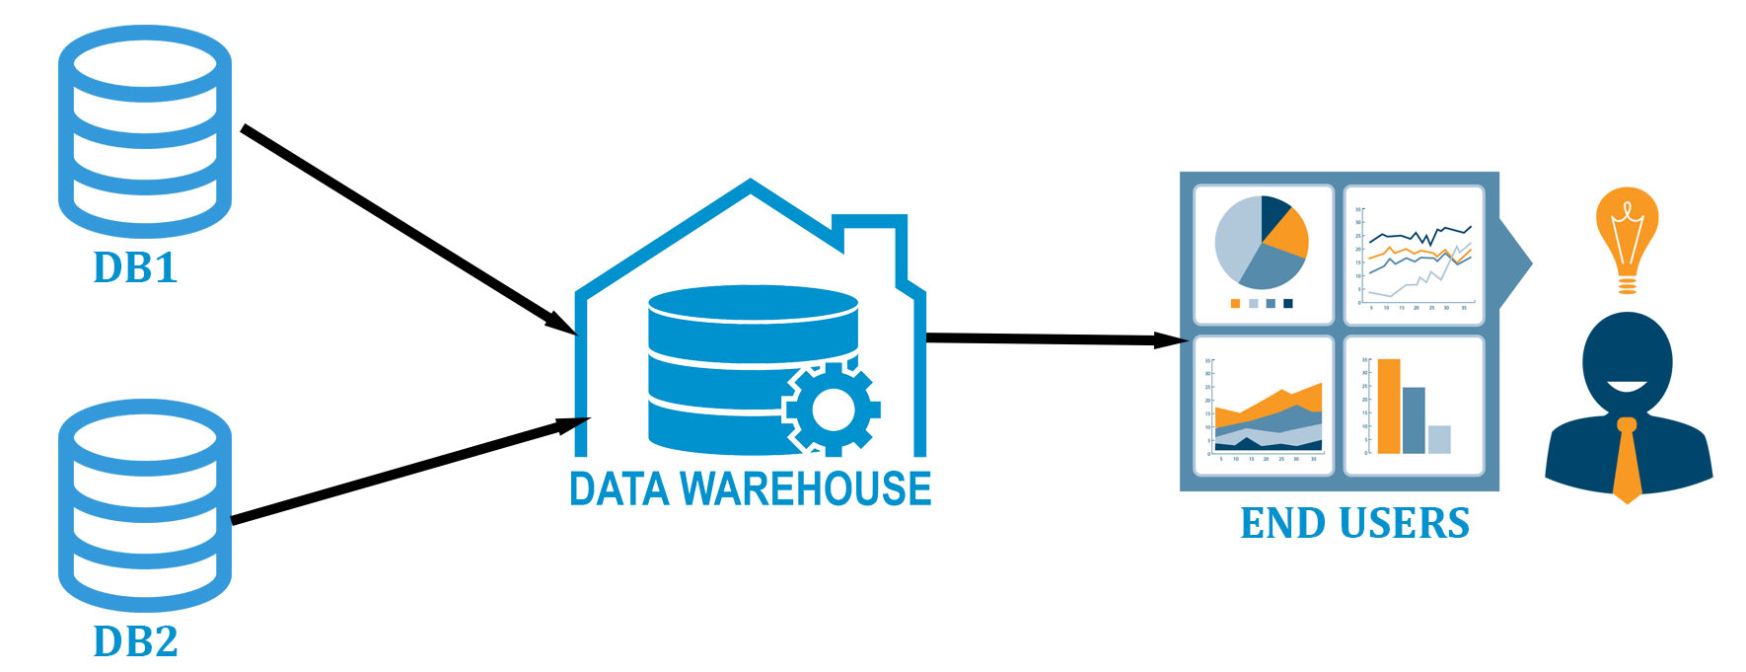

What is BI
Business Intelligence is the act of transforming raw/ operational data into useful information for business analysis.

